Slide 1
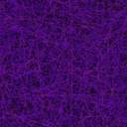
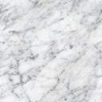
Scene Text Detection and Recognition
under Texture Text Images
Tanakit Intaniyom 60070141
Phandit Chantanam 60070149
Warinthorn Thananaporn 60070156

Slide 2

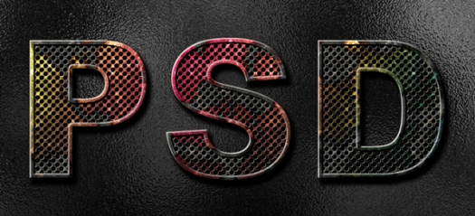
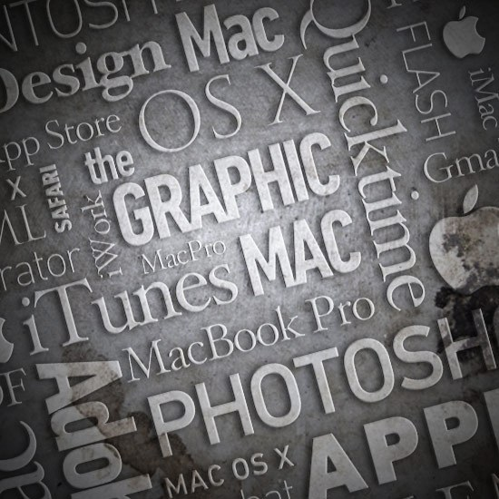
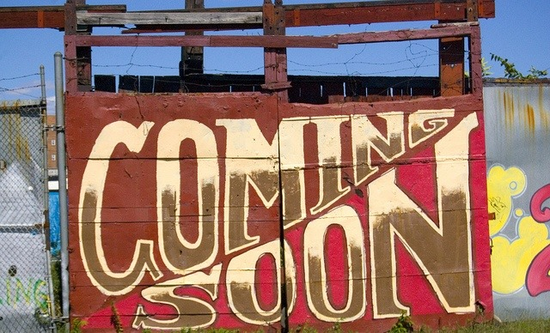
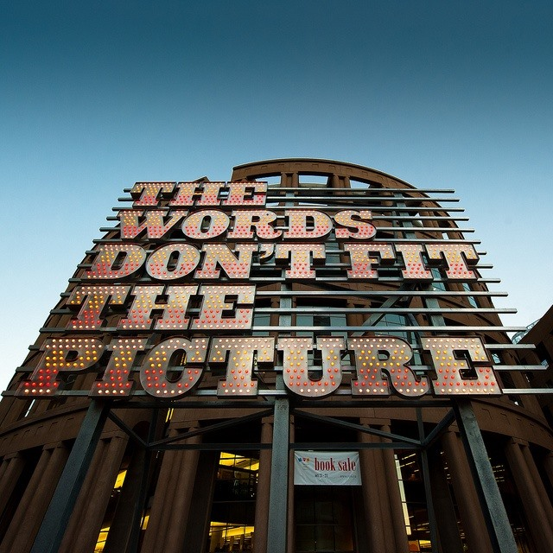
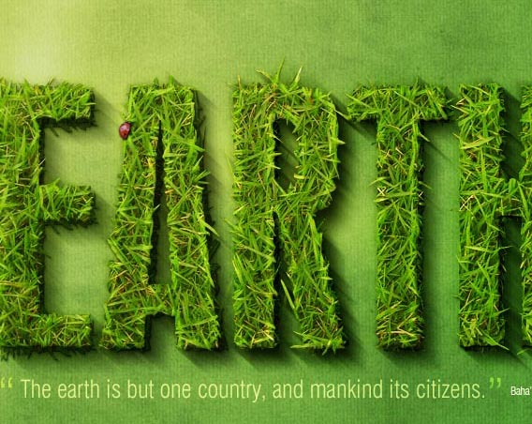


Slide 3
PLAN A

Slide 4
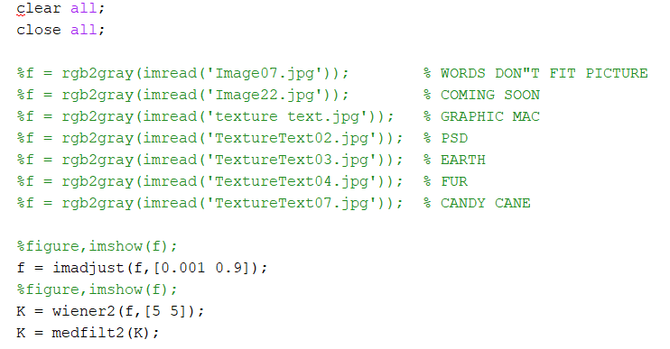
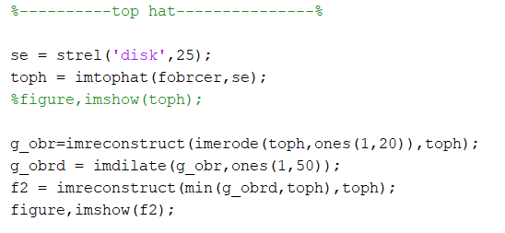
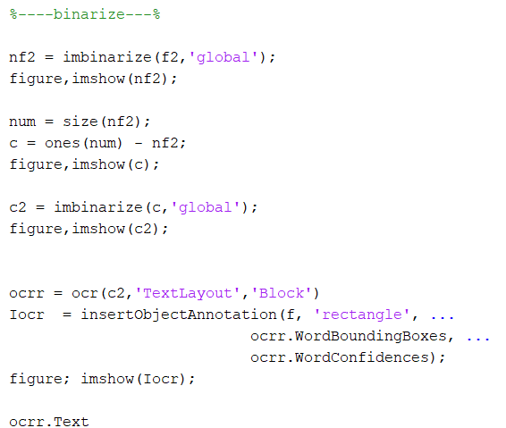
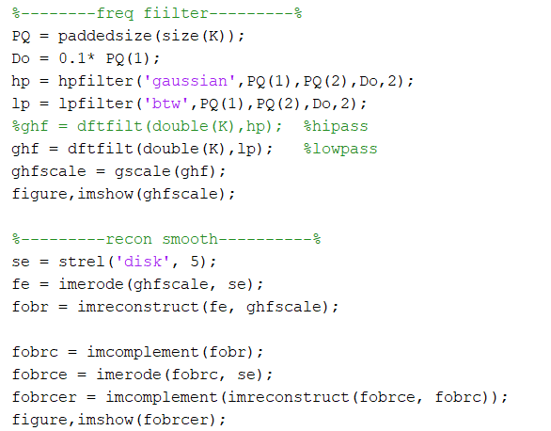

Slide 5

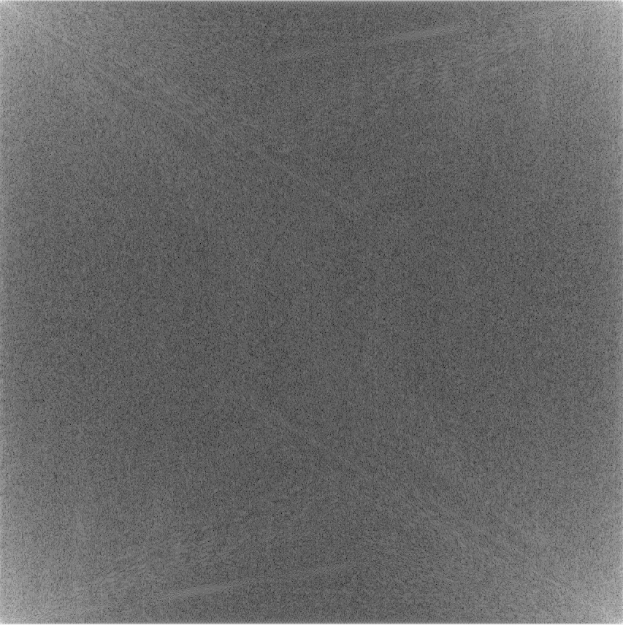
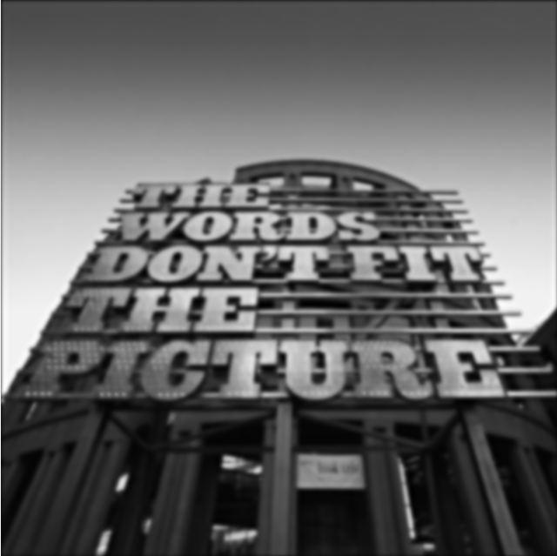



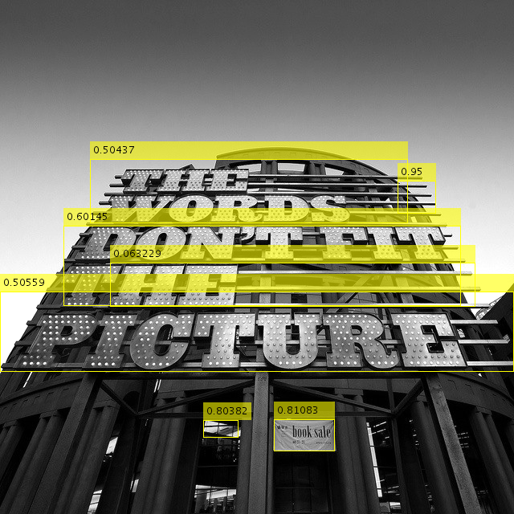

Slide 6
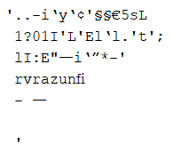
BB (Bounding Box) | Confidence | Regconized Text | Recognition Rate
THE | 0.50437 |  | 0
WORDS | 0.50437 |  | 0
DON'T | 0.60145 |  | 0
FIT | 0.60145 |  | 0
THE | 0.60145 |  | 0
PICTURE | 0.50559 |  | 0
Average | 0.55311333 |  | 0

Slide 7

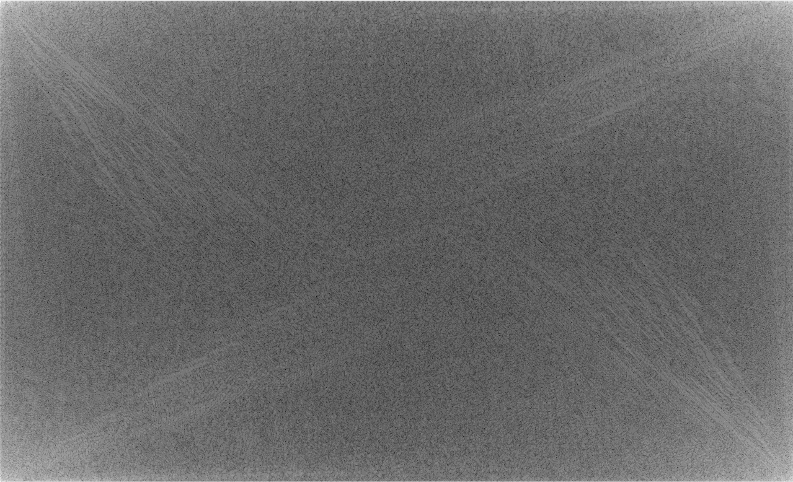
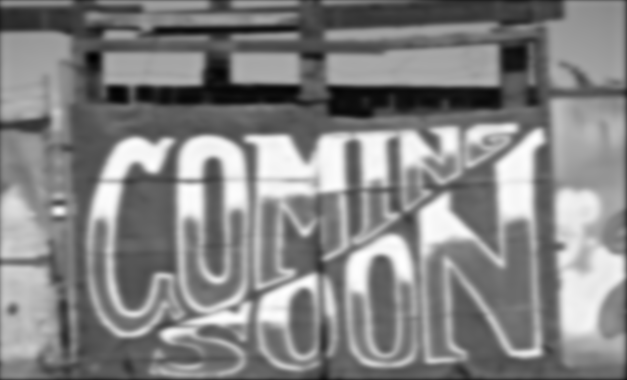



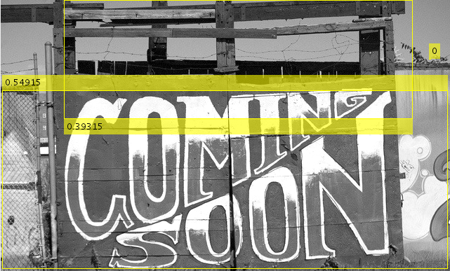

Slide 8
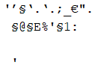
BB (Bounding Box) | Confidence | Regconized Text | Recognition Rate
COMING | 0.54915 |  | 0
SOON | 0.54915 |  | 0
Average | 0 |  | 0

Slide 9

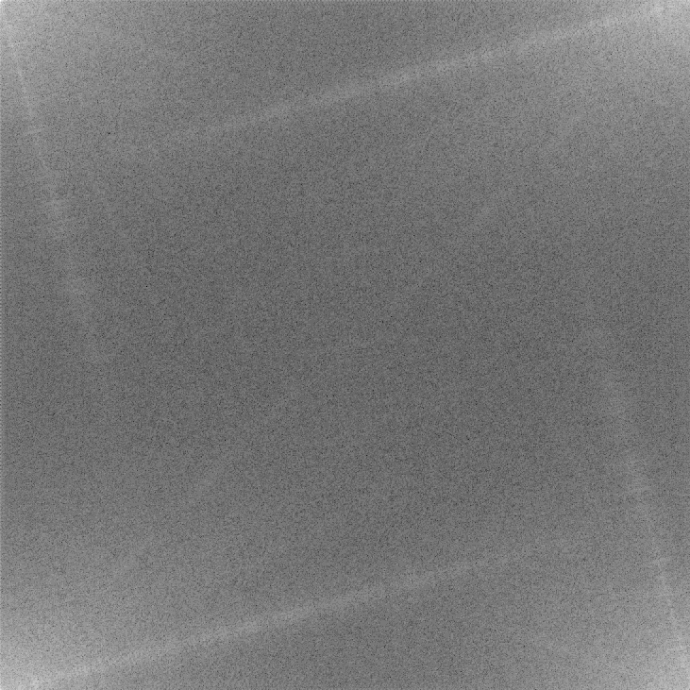




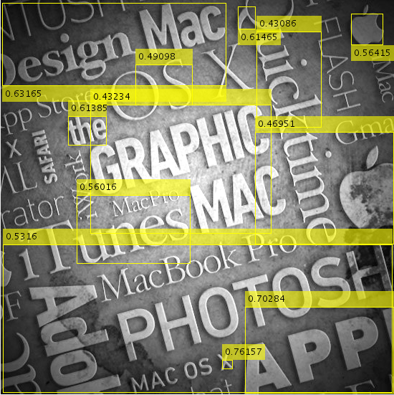

Slide 10
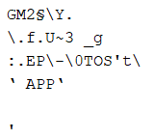
BB (Bounding Box) | Confidence | Regconized Text | Recognition Rate
DESIGN | 0.63165 |  | 0
MAC | 0.63165 |  | 0
OS X | 0.49098 |  | 0
THE | 0.61385 |  | 0
GRAPHIC | 0.43234 |  | 0
MACPRO | 0.56016 |  | 0
ITUNES | 0.56016 |  | 0
MACBOOK PRO | 0.5316 |  | 0
PHOTOS | 0.5316 | TOS | 50
APP | 0.70284 | APP | 100
QUICKTIME | 0.43086 |  | 0
FLASH | 0 |  | 0
STORE | 0 |  | 0
Average | 0.47059154 |  | 11.53846154

Slide 11

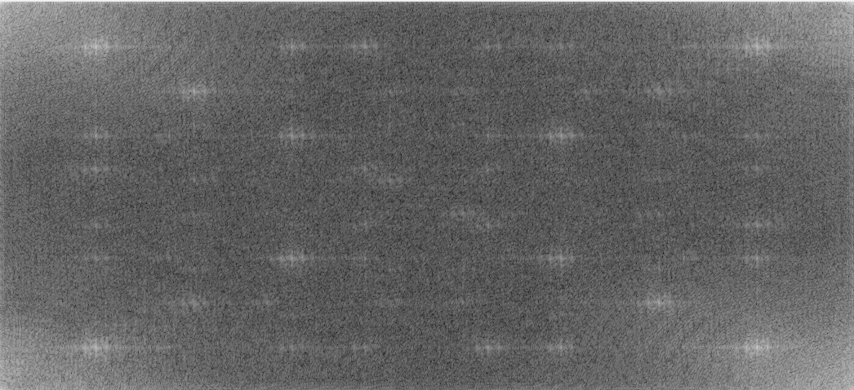
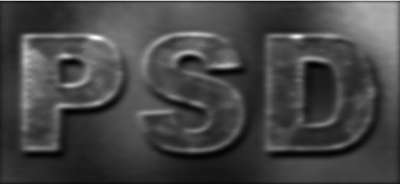
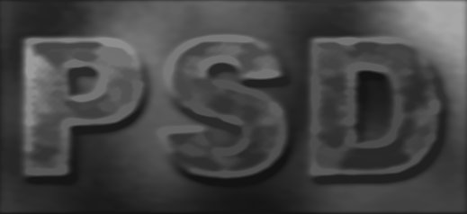
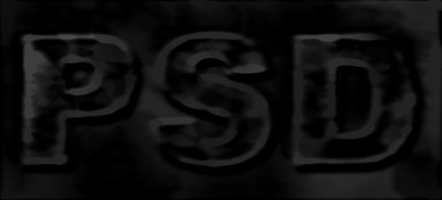

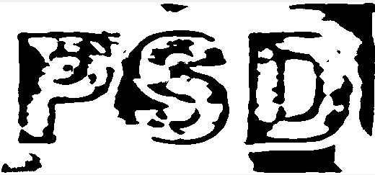


Slide 12
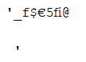
BB (Bounding Box) | Confidence | Regconized Text | Recognition Rate
PSD | 0 |  | 0
Average | 0 |  | 0

Slide 13


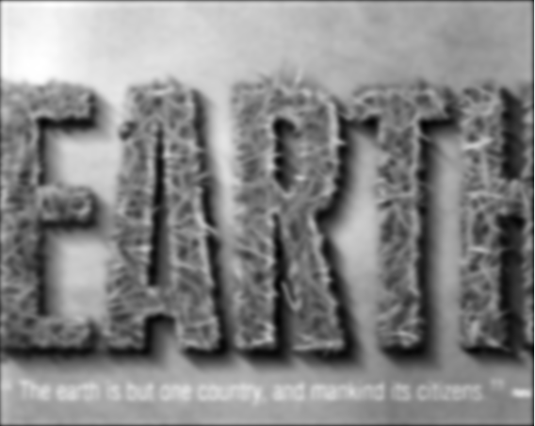

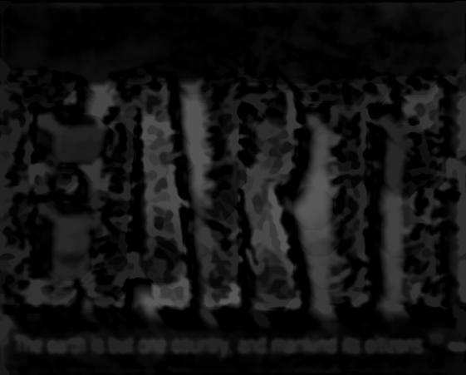



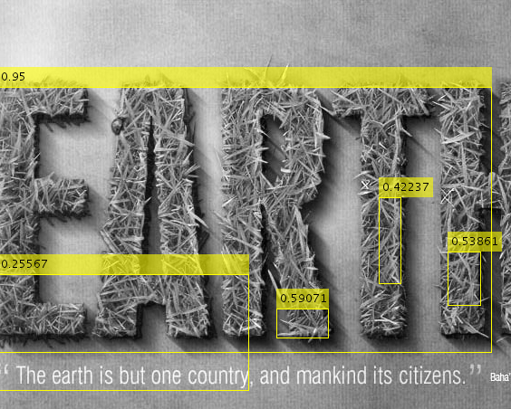

Slide 14
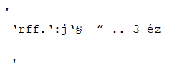
BB (Bounding Box) | Confidence | Regconized Text | Recognition Rate
EARTH | 0.95 |  | 0
Average | 0.95 |  | 0

Slide 15








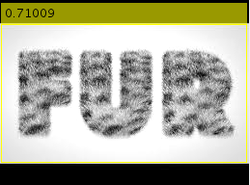

Slide 16
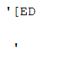
BB (Bounding Box) | Confidence | Regconized Text | Recognition Rate
FUR | 0.71009 | [ED | 0
Average | 0 |  | 0

Slide 17

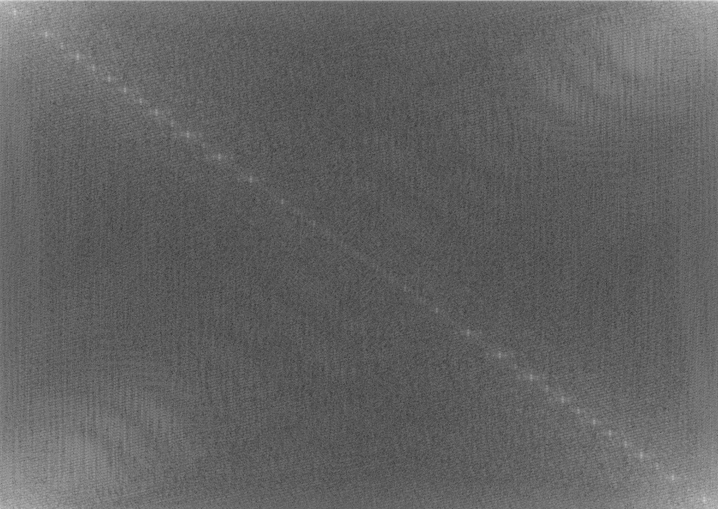



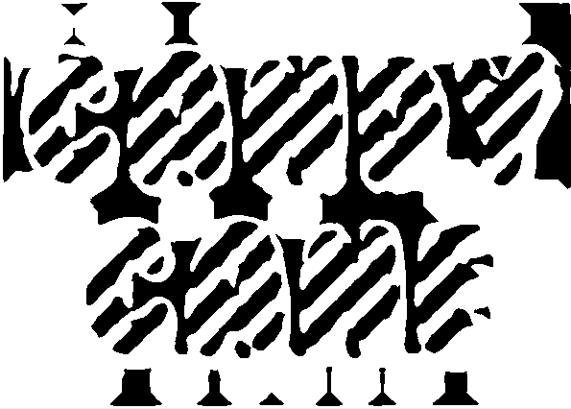


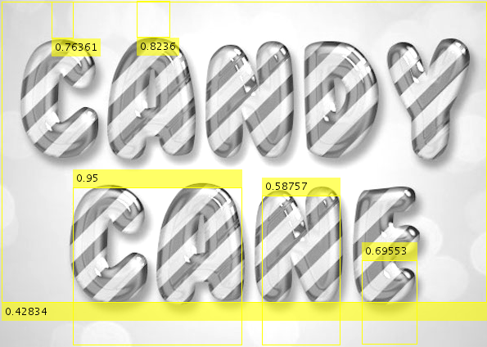

Slide 18
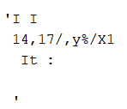
BB (Bounding Box) | Confidence | Regconized Text | Recognition Rate
CA | 0.95 |  | 0
N | 0.58757 |  | 0
Average | 0.768785 |  | 0

Slide 19
PLAN B

Slide 20
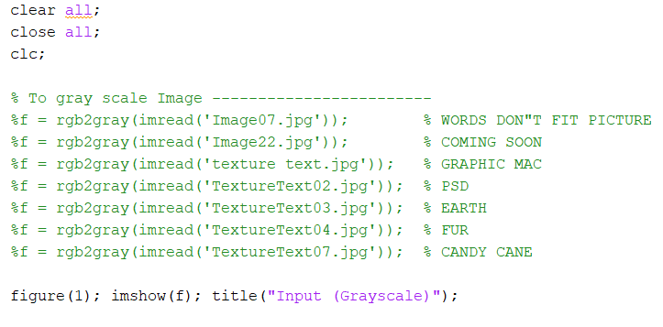
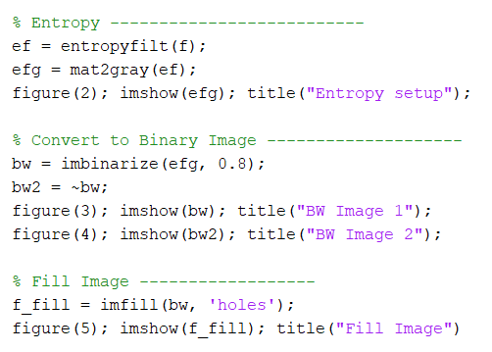
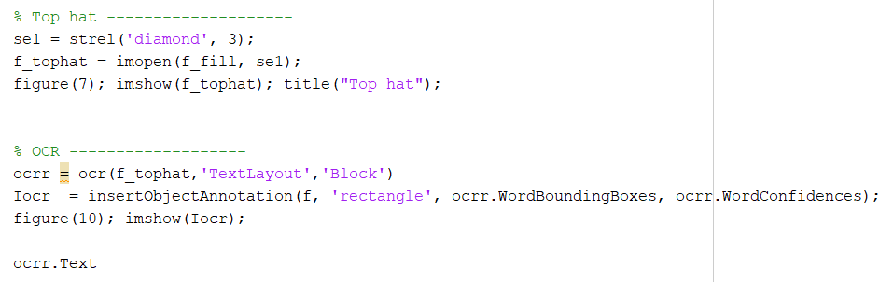

Slide 21
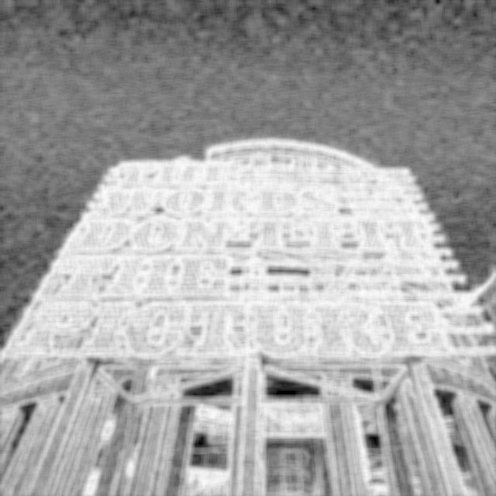
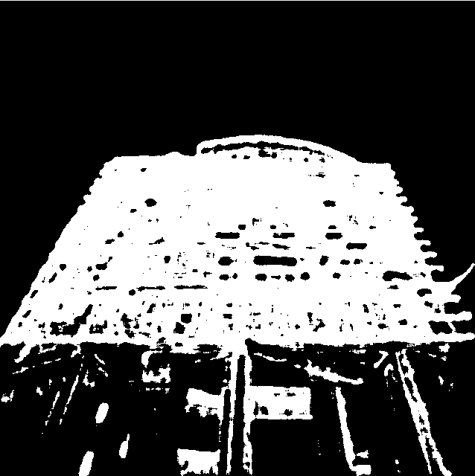
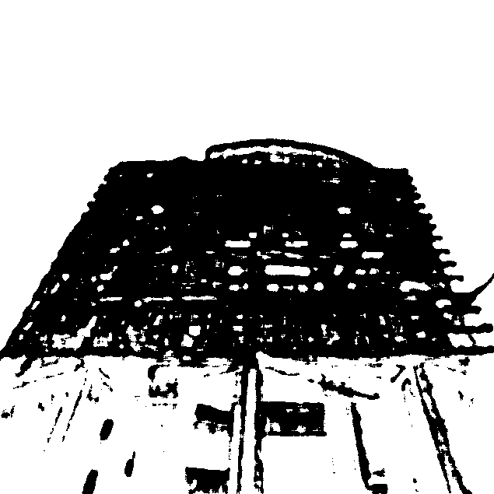
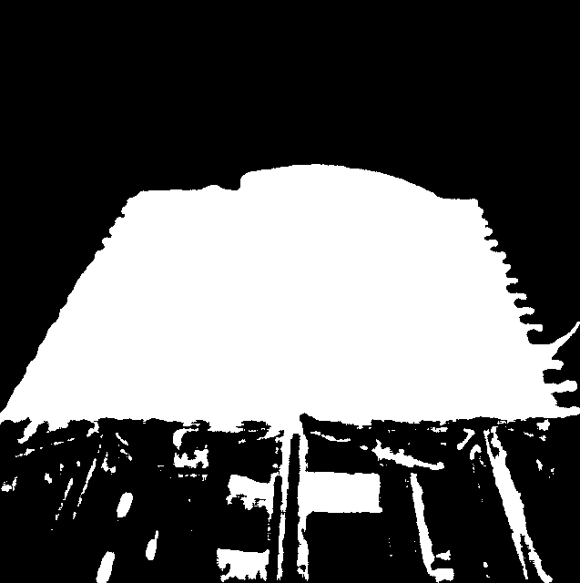
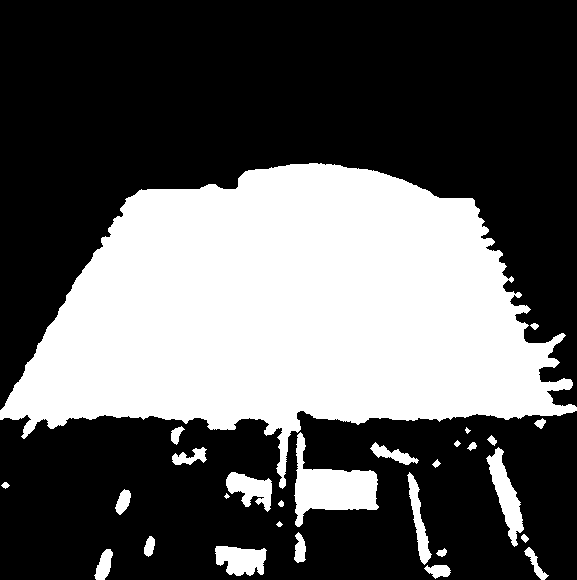
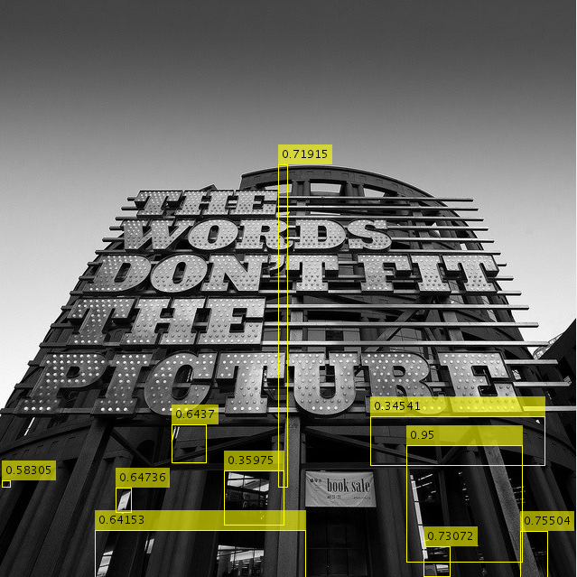

Slide 22
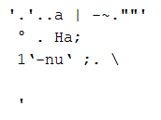

Slide 23
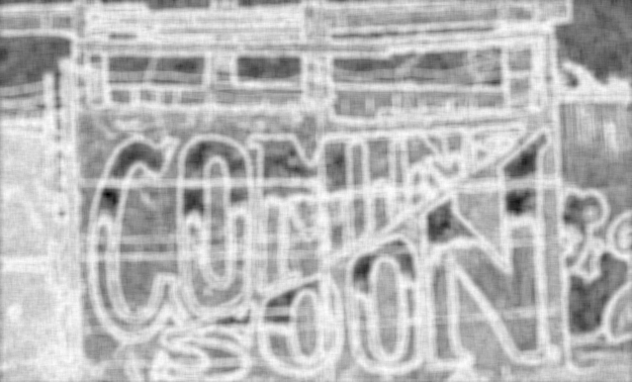

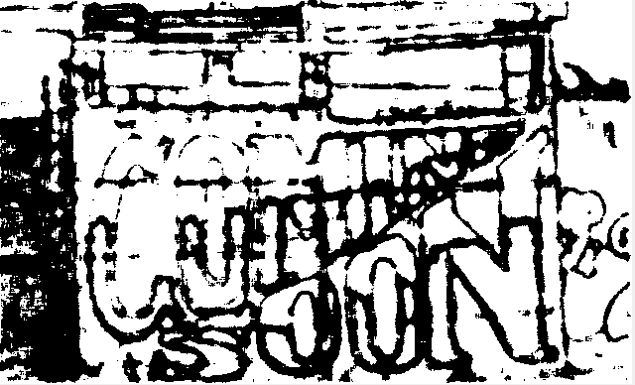




Slide 24


Slide 25







Slide 26


Slide 27







Slide 28

BB (Bounding Box) | Confidence | Regconized Text | Recognition Rate
PSD | 0.50463 | P39 | 33
Average | 0.50463 |  | 33

Slide 29







Slide 30

BB (Bounding Box) | Confidence | Regconized Text | Recognition Rate
THE EARTH IS BUT ONE COUNTRY, AND MANKIND IT'S CITIZENS | 0.58181 |  | 0
Average | 0.58181 |  | 0

Slide 31






Slide 32







Slide 33

BB (Bounding Box) | Confidence | Regconized Text | Recognition Rate
CANDY | 0.95 | GOES | 0
CANE | 0.59893 |  | 0
Average | 0.774465 |  | 0

Slide 34
Comparison

Slide 35
A
B

Slide 36
A
B

Slide 37
A
B

Slide 38
A
B

Slide 39
A
B

Slide 40
A
B

Slide 41
OCR Analysis

Slide 42



Slide 43
Thank you

